Slide 1
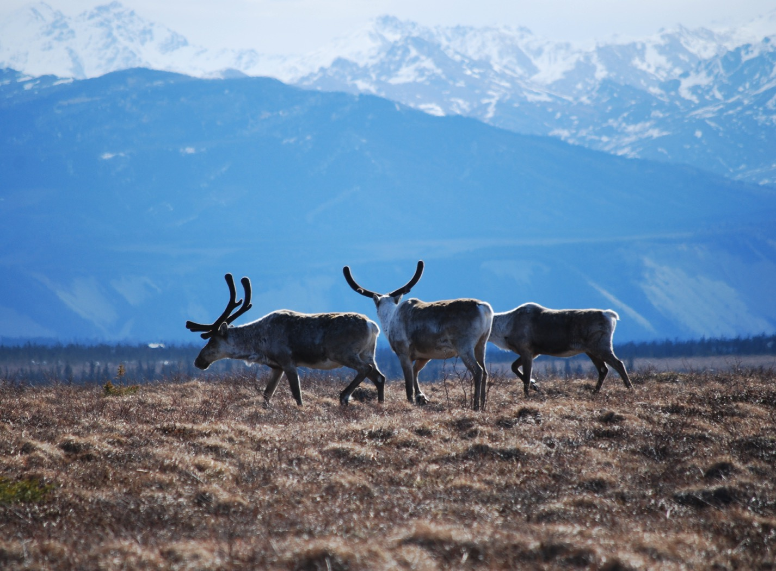
Arctic Boreal Vulnerability Experiment (ABoVE)
2017 ABoVE Airborne Campaign
29 April 2017 (DOY 120)
Atmospheric C: Inuvik – Fairbanks
Charles Miller, Deputy Science Lead
Jet Propulsion Laboratory, California Institute of Technology
and the ABoVE Science Team For Hank Margolis, Eric Kasichke, Bruce Tagg
NASA HQ
April 2017

Slide 2
29 Apr 2017/DOY 120 Inuvik – Fairbanks
Assets Deployed:
Inuvik – Mooney (N617DH)/Atmospheric CO2, CH4, CO
Daily Summary:
Science Flight
All sensors operating nominally

Slide 3
29 Apr 2017/DOY 120 72-Hour Look Ahead
All plans weather dependent
Sunday 30 April 2017 (DOY 121):
Fairbanks – Galena - Nome
Vertical profiles over Galena, Nome
Monday 1 May 2017 (DOY 122):
TBD
Tuesday 2 May 2017 (DOY 123):
TBD

Slide 4
29 Apr 2017/DOY 120 Inuvik – Fairbanks
Flight Plan:
Inuvik – Old Crow – Fort Yukon – Fairbanks

Slide 5
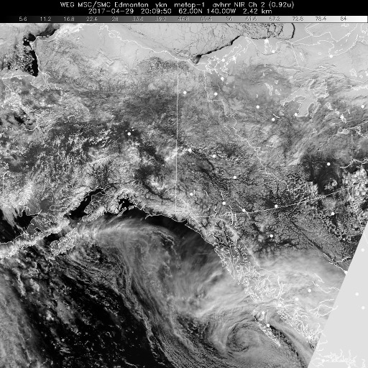
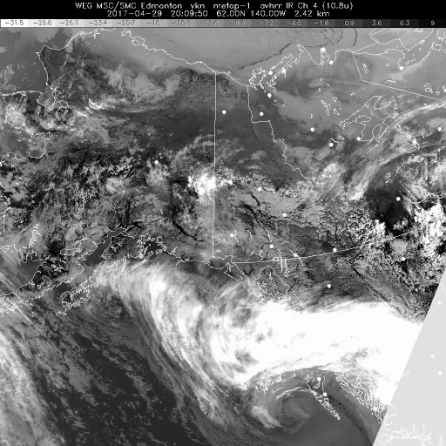
29 Apr 2017/DOY 120 Inuvik – Fairbanks
HRPT NIR
HRPT IR
HRPT Polar NIR (left) and IR (right) show mostly clear conditions between Inuvik and Fairbanks

Slide 6
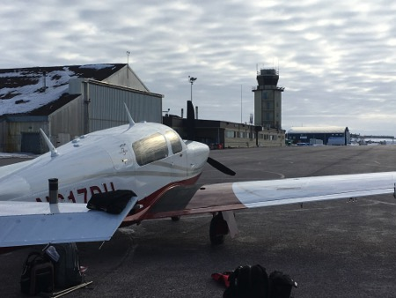
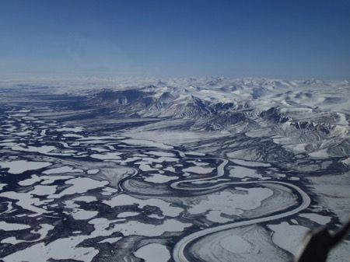
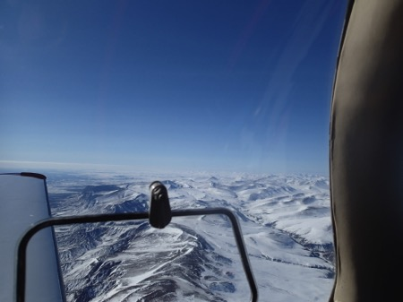
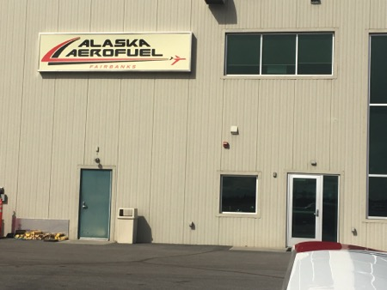
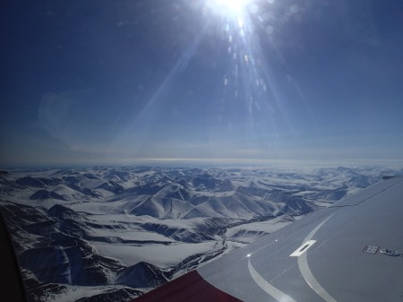
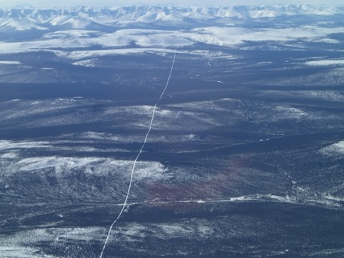
29 Apr 2017/DOY 120 Inuvik – Fairbanks
Inuvik
Stevens Village
Beaver
Alaska – Canada
Border
Fairbanks
Frozen landscapes dominate on the flight from Inuvik to Fairbanks

Slide 7
29 Apr 2017/DOY 120 Inuvik – Fairbanks
CO2, CH4 and CO vertical profiles vs altitude and latitude
Descents Old Crow, Fort Yukon and Fairbanks
Elevated CO2 and CH4 observed below 1 km elev on all descents

Slide 8
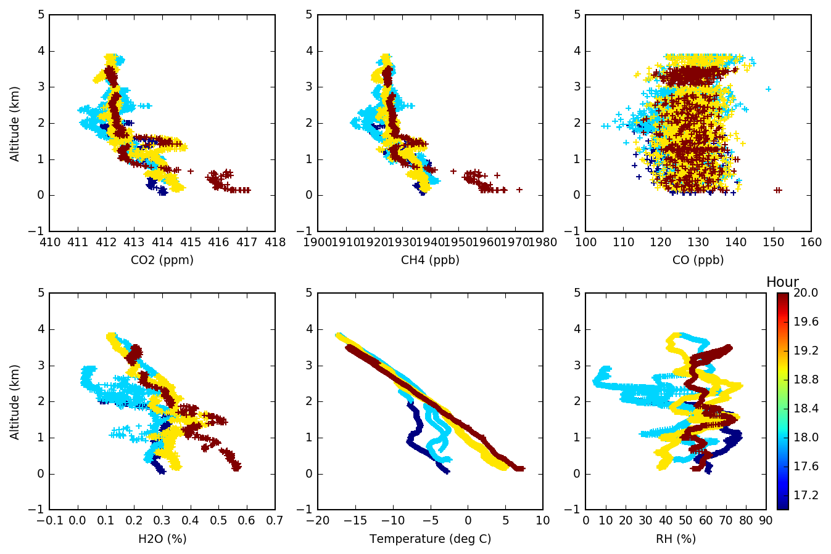
29 Apr 2017/DOY 120 Inuvik – Fairbanks
Notes:
Profiles show +2-5 ppm CO2 and +20-50 ppb CH4 near surface enhancements

Slide 9
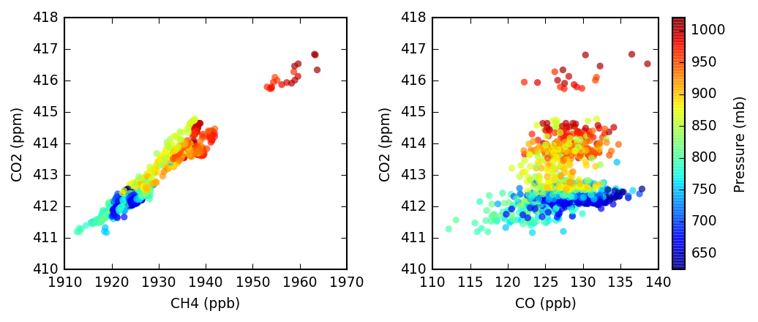
29 Apr 2017/DOY 120 Inuvik – Fairbanks
CO2 v CH4 and CO2 v CO tracer-tracer correlation plots
Near surface CO2 v CH4 enhancements show evidence of spring thaw
Modest CO enhancements (CO > 130 ppb) at all altitudes

